Slide 1
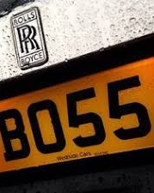
Detection of Car Registration Number
project by
Karan Juneja (U15CO073) Karishma Wadhwaney (U15CO078)

Slide 2
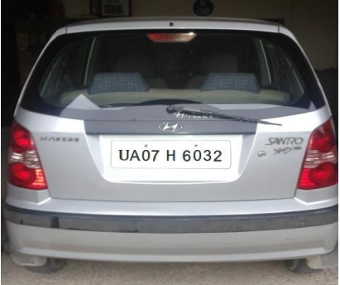
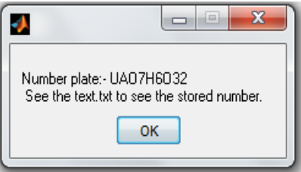
Aim:
This project proposes a method for the detection and identification of vehicle number plate (converting image in text format).

Slide 3
Insight :
This paper presents an approach based on simple but efficient morphological operation and Sobel edge detection method.
This approach is simplified to segmented all the letters and numbers used in the number plate by using bounding box method.
After segmentation of numbers and characters present on number plate, template matching approach is used to recognition of numbers and characters.
The concentrate is given to locate the number plate region properly to segment all the number and letters to identify each number separately

Slide 4
Process:
Step 1
Input Image
Step 2
Extraction of Number Plate Location
Step 3
Remove connected objects on border
Step 4
Character Segmentation
Step 5
Character recognition and display result

Slide 5
TRIALS SHOTS

Slide 6
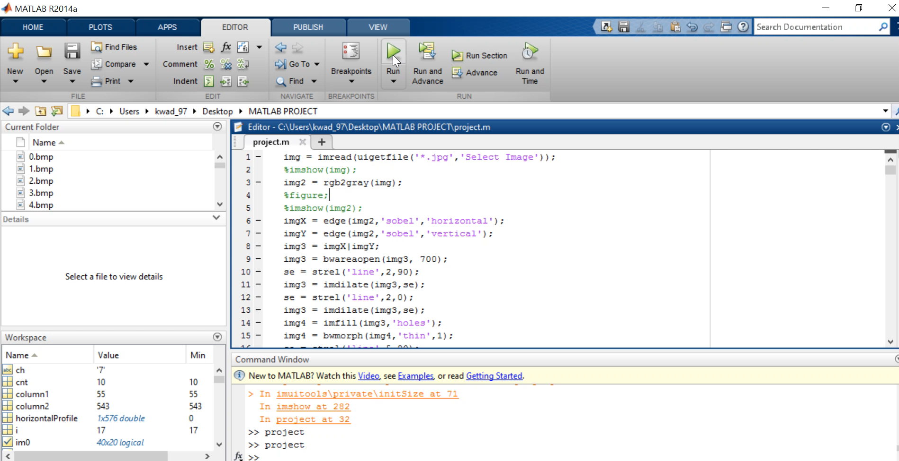

Slide 7
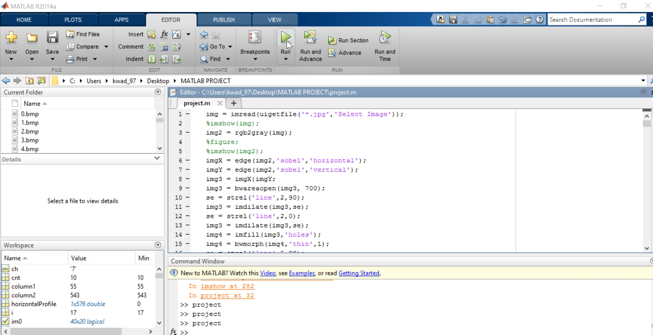

Slide 8
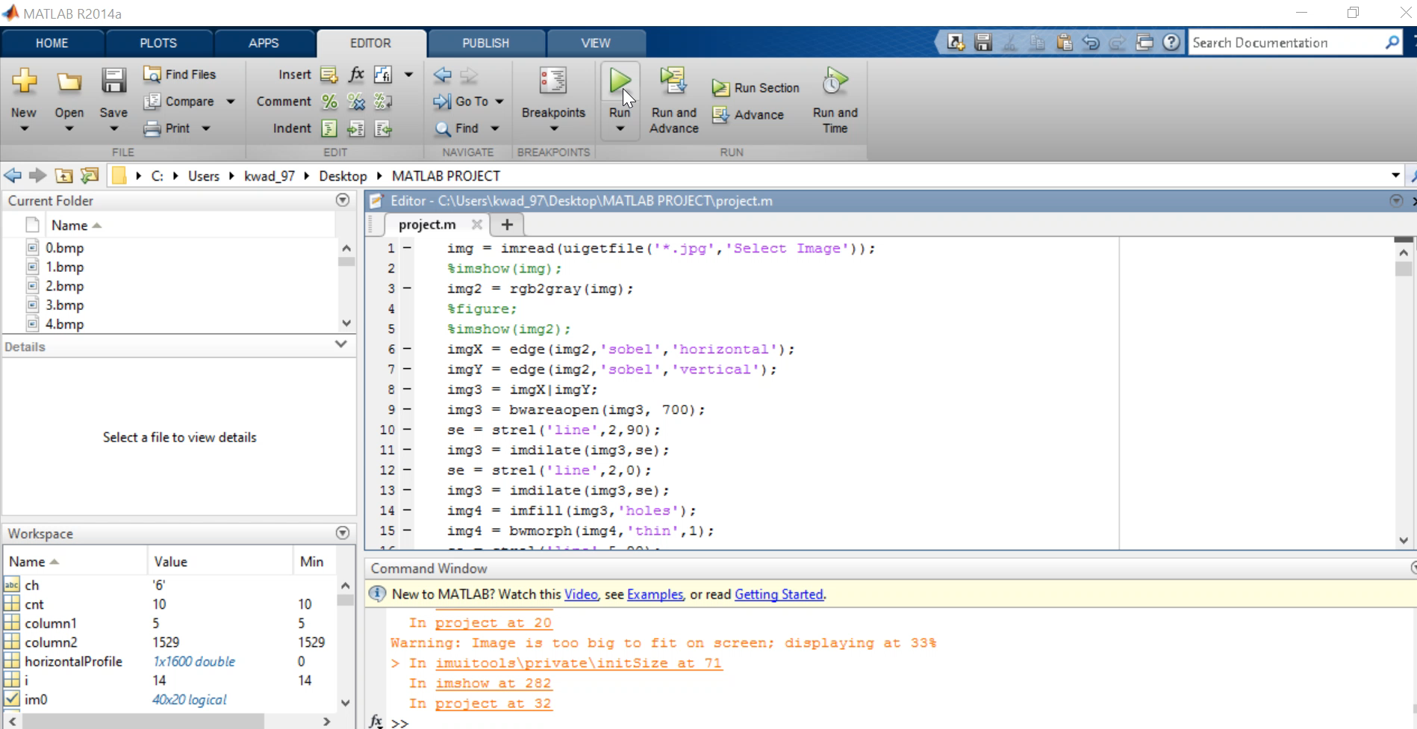

Slide 9
Applications:
1. Parking :- The NPR is used to automatically enter prepaid members and calculate parking fee for nonmembers.
2. Access control :- A gate automatically opens for authorized members in a secured area, thus replacing or assisting the security guard.
3. Tolling :- The car number is used to calculate the travel fee in a toll-road or used to double check the ticket.
4. Border Security :- The car number is registered in the entry or exits to the country and used to monitor the border crossings.
5. Traffic Control :- The vehicles can be directed to different lanes according to their entry permits. The system reduces the traffic congestions and number of attendants.
6. Airport Parking :- In order to reduce ticket frauds or mistakes, the NPR unit is used to capture the number plate and image of the car.

Slide 10
Limitations:
Broken number plate.
Blurry images.
Number plate not within the legal specification. we detect plates of format ( XX 11 XX 1111 )
Low resolution of the characters.
Poor maintenance of the vehicle plate.
Similarity between certain characters, namely, O and D; 5 and S; 8 and B, E; O and 0, etc.

Slide 11
References :
INTERNATIONAL JOURNAL OF INNOVATIVE RESEARCH IN ELECTRICAL, ELECTRONICS, INSTRUMENTATION AND CONTROL ENGINEERING Vol. 2, Issue 8, August 2014
RECOGNITION OF VEHICLE NUMBER PLATE USING MATLAB
Ragini Bhat1 , Bijender Mehandia2
Student, ECE Department, Gurgaon Institute of Technology & Management,Gurgaon, India1
Professor, ECE Department, Gurgaon Institute of Technology & Management, Gurgaon, India2
(PDF available)
http://in.mathworks.com/help

Slide 12
Thank you
SOFTWARE TOOLS II MINI PROJECT
II YEAR , SARDAR VALLABHBHAI NATIONAL INSTITUTE OF TECHNOLOGY, SURAT

